Slide 1
A Self-Tuning Fill Factor Technique for SQL Server
Mike Byrd
Database Engineer
ByrdNest Consulting, Sunrise Beach, Texas

Slide 2



Mike
Byrd
Database Engineer
ByrdNest Consulting
Sunrise Beach, Texas
Former AF Fighter Pilot, Rocket Scientist, and now SQL Server Geek. Specialize in SQL Server performance tuning. I’m currently self-employed and consult part-time. I’ve had one client for 15+ years.
Mbyrd@ByrdNest-TX.com
www.TSQLMentoring.com
Notes:
Peter

Slide 3


Slide 4
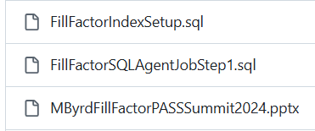
Presentation slides and T-SQL code are available at https://github.com/MByrdTX
You don’t need to take notes; just listen and review slides and scripts later.

Slide 5




Who is Mike Byrd
In former times
Rocket Scientist
USAF Fighter Pilot (F-4, F-5)
Free-lance tech writer for PC Magazine
CTO, Texas Windstorm Insurance Company
Part-time Database Consultant/Trainer
Pre-covid blogging at https://Logicalread.com &
Http://www.sqlservercentral.com
Digging deeper into the optimizer black box

Slide 6
Overview
Fill Factor
What is it?
How is it used?
Approach
Short Review of Code
Analysis
Conclusions/Observations
No Demos ☹

Slide 7
Overview
Early version of code/presentation documented at https://www.sqlservercentral.com/articles/a-self-tuning-fill-factor-technique-for-sql-server-part-1
and https://www.sqlservercentral.com/articles/a-self-tuning-fill-factor-technique-for-sql-server-part-2
Early video from Austin User’s Group at http://usergroup.tv/videos/a-self-tuning-fill-factor-technique-for-sql-server
But latest code & slides at GitHub

Slide 8
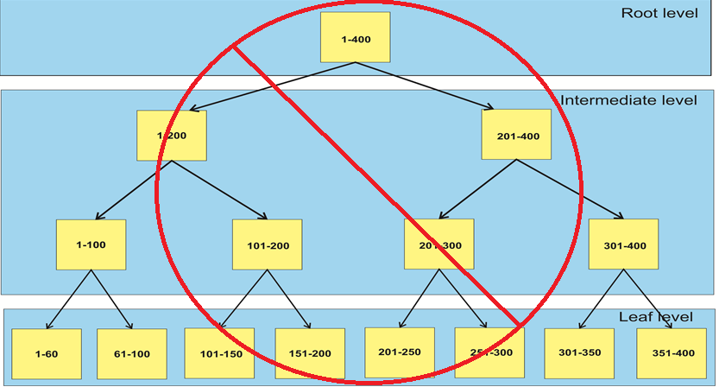
Index Structure (B-Tree) – not exactly correct!

Slide 9
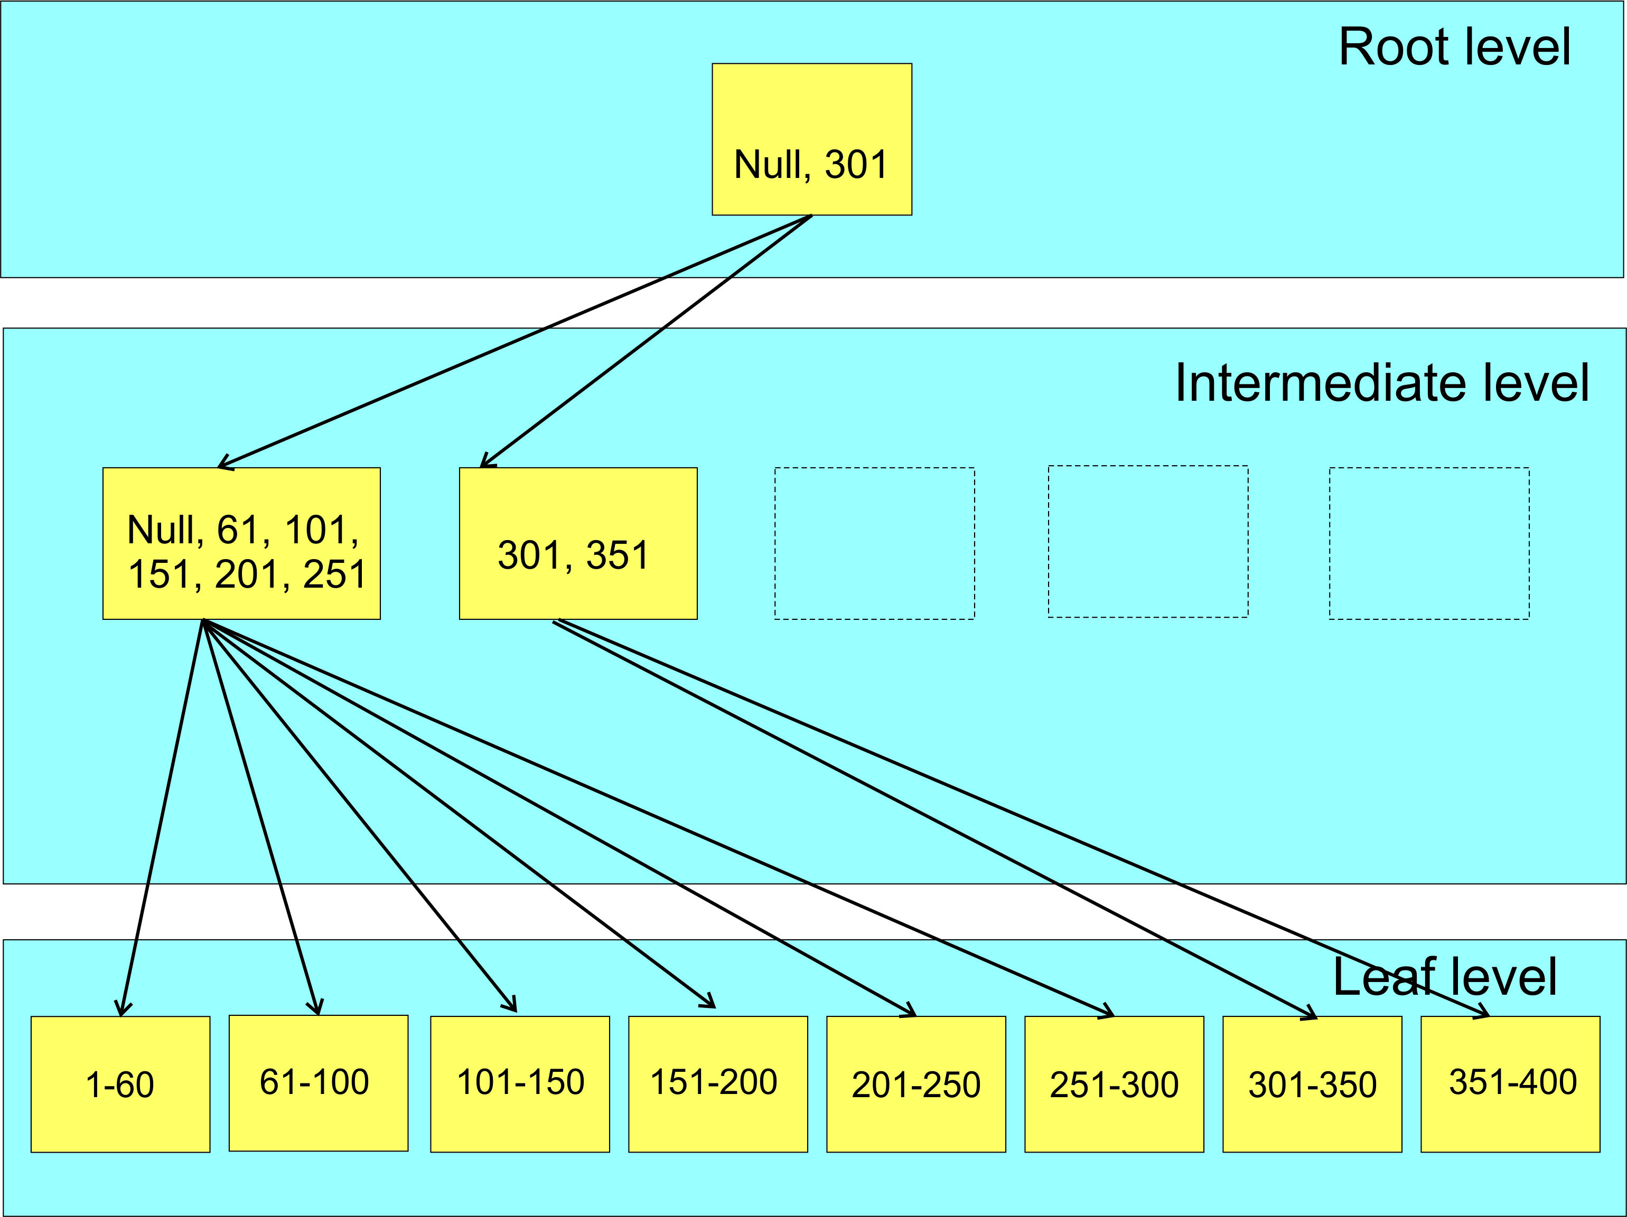
Index Structure (B-Tree)

Slide 10

Fill Factor
Percent of fullness of leaf level pages of an index
So what happens when a page cannot accommodate a new row?

Slide 11
SQL Server Fill Factor
SQL Server Fill Factor
Good Page Splits

Slide 12
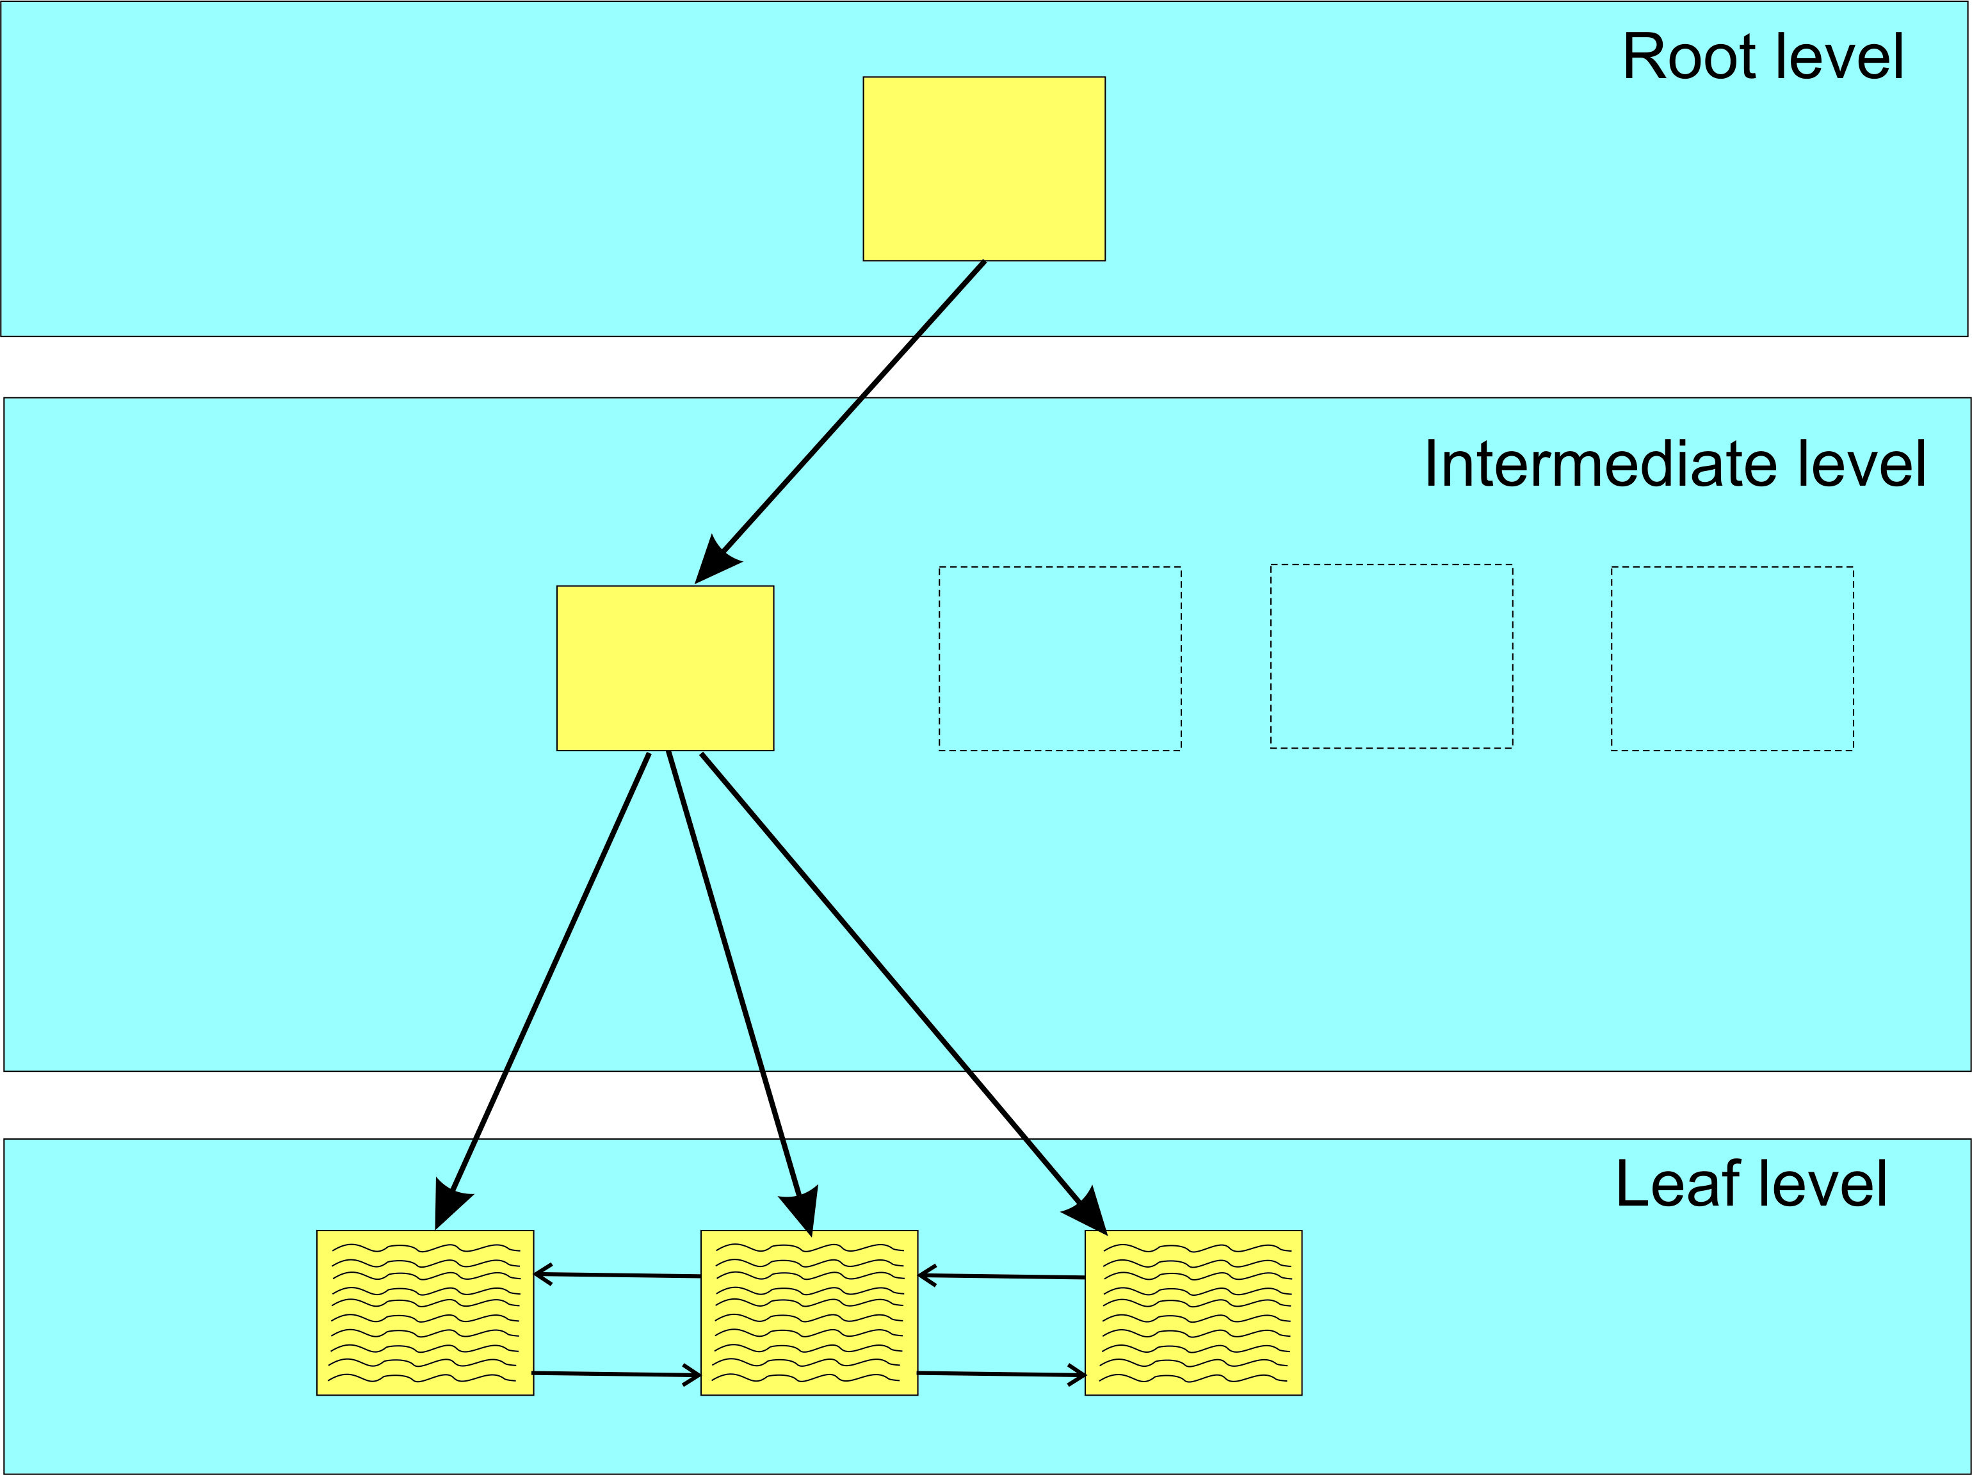
Partial view of B-Tree before adding row
.

Slide 13
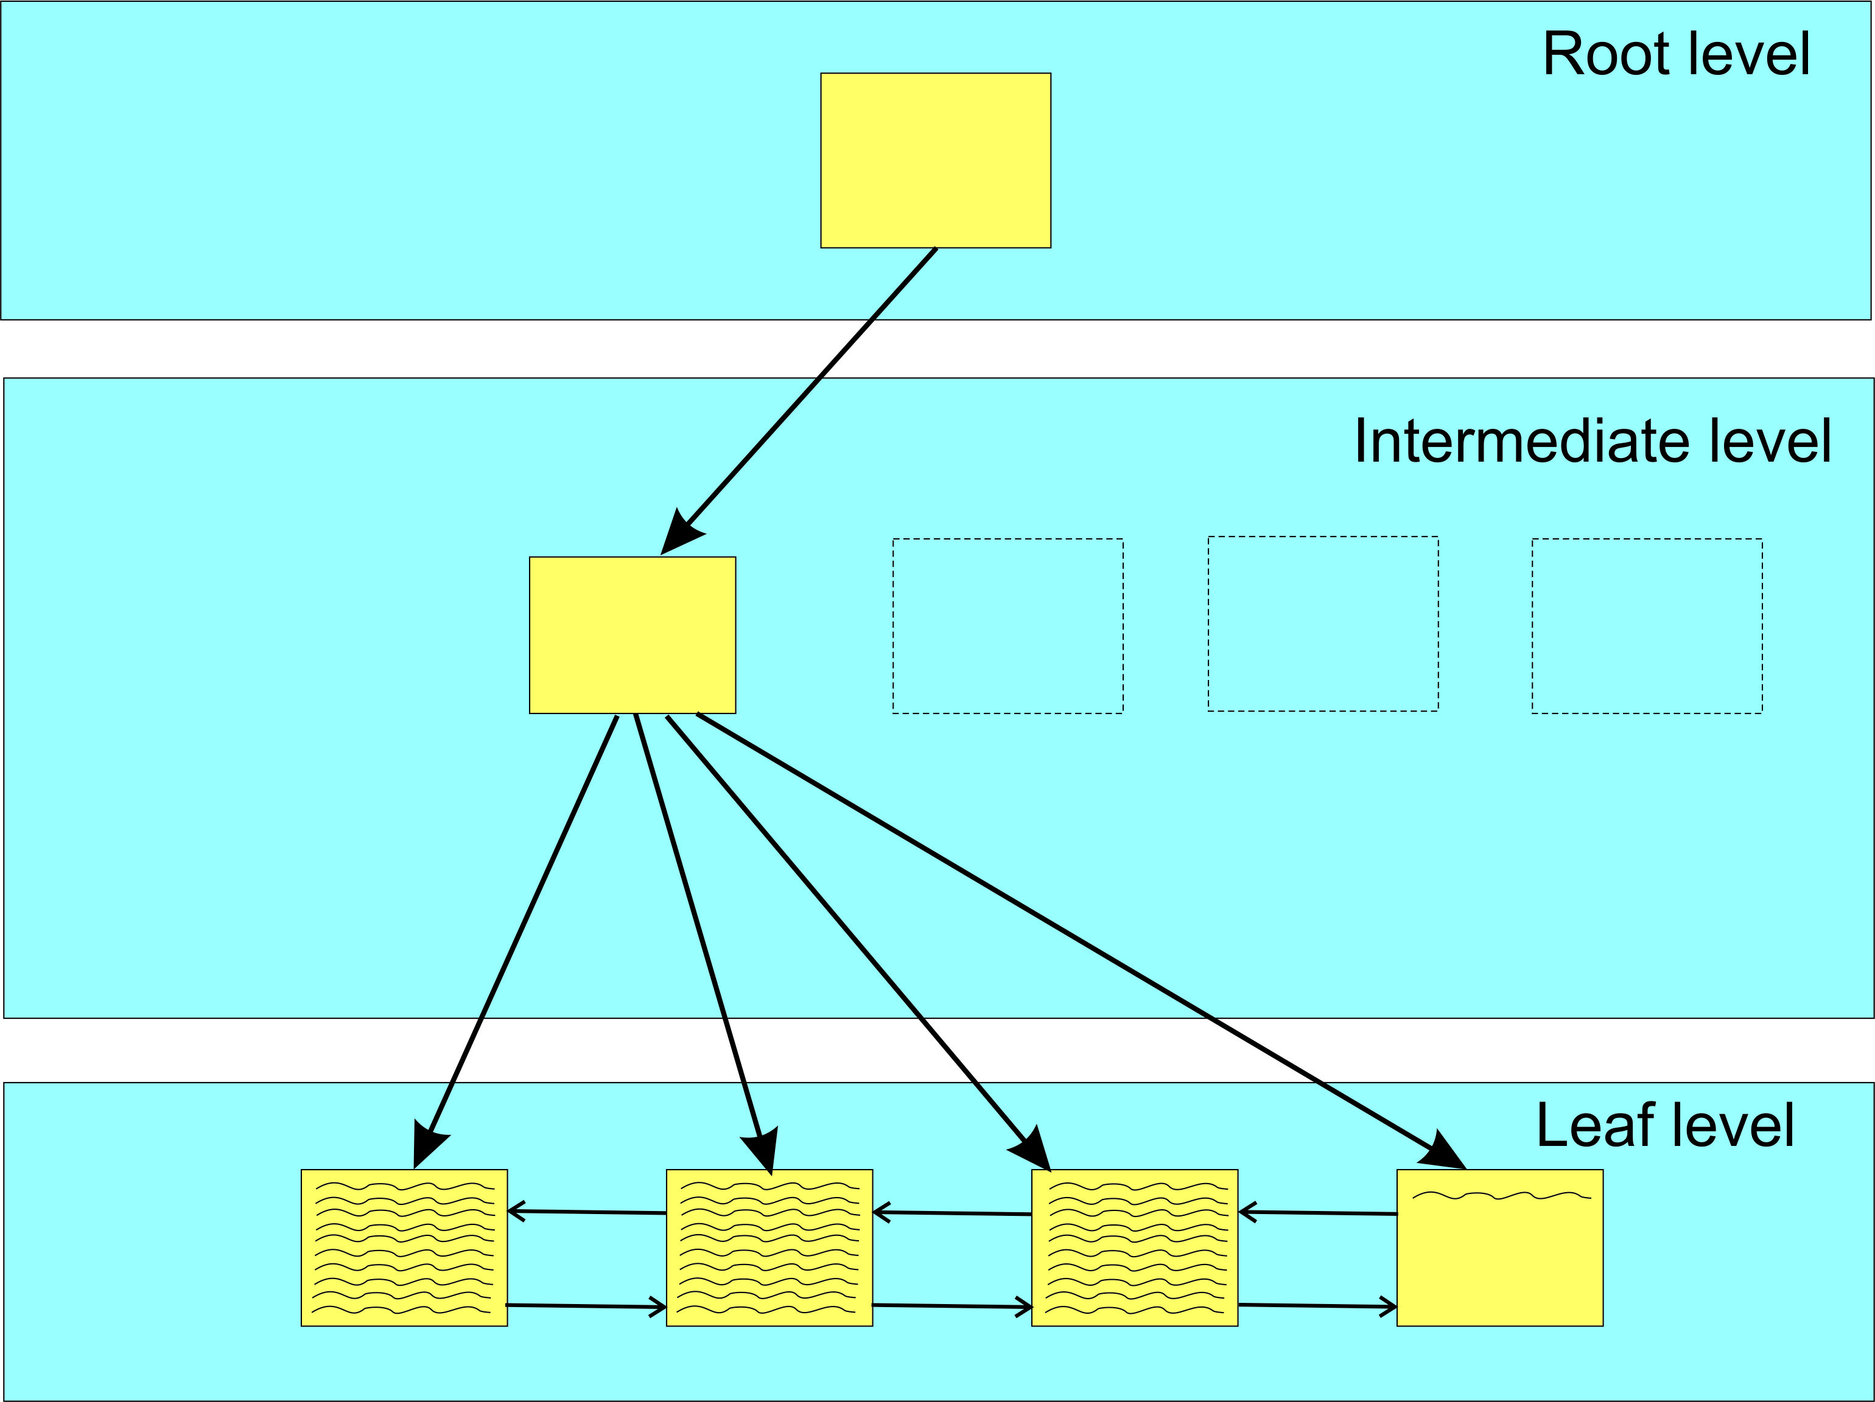
After adding row to index (Identity column)
.
Good Page Split

Slide 14
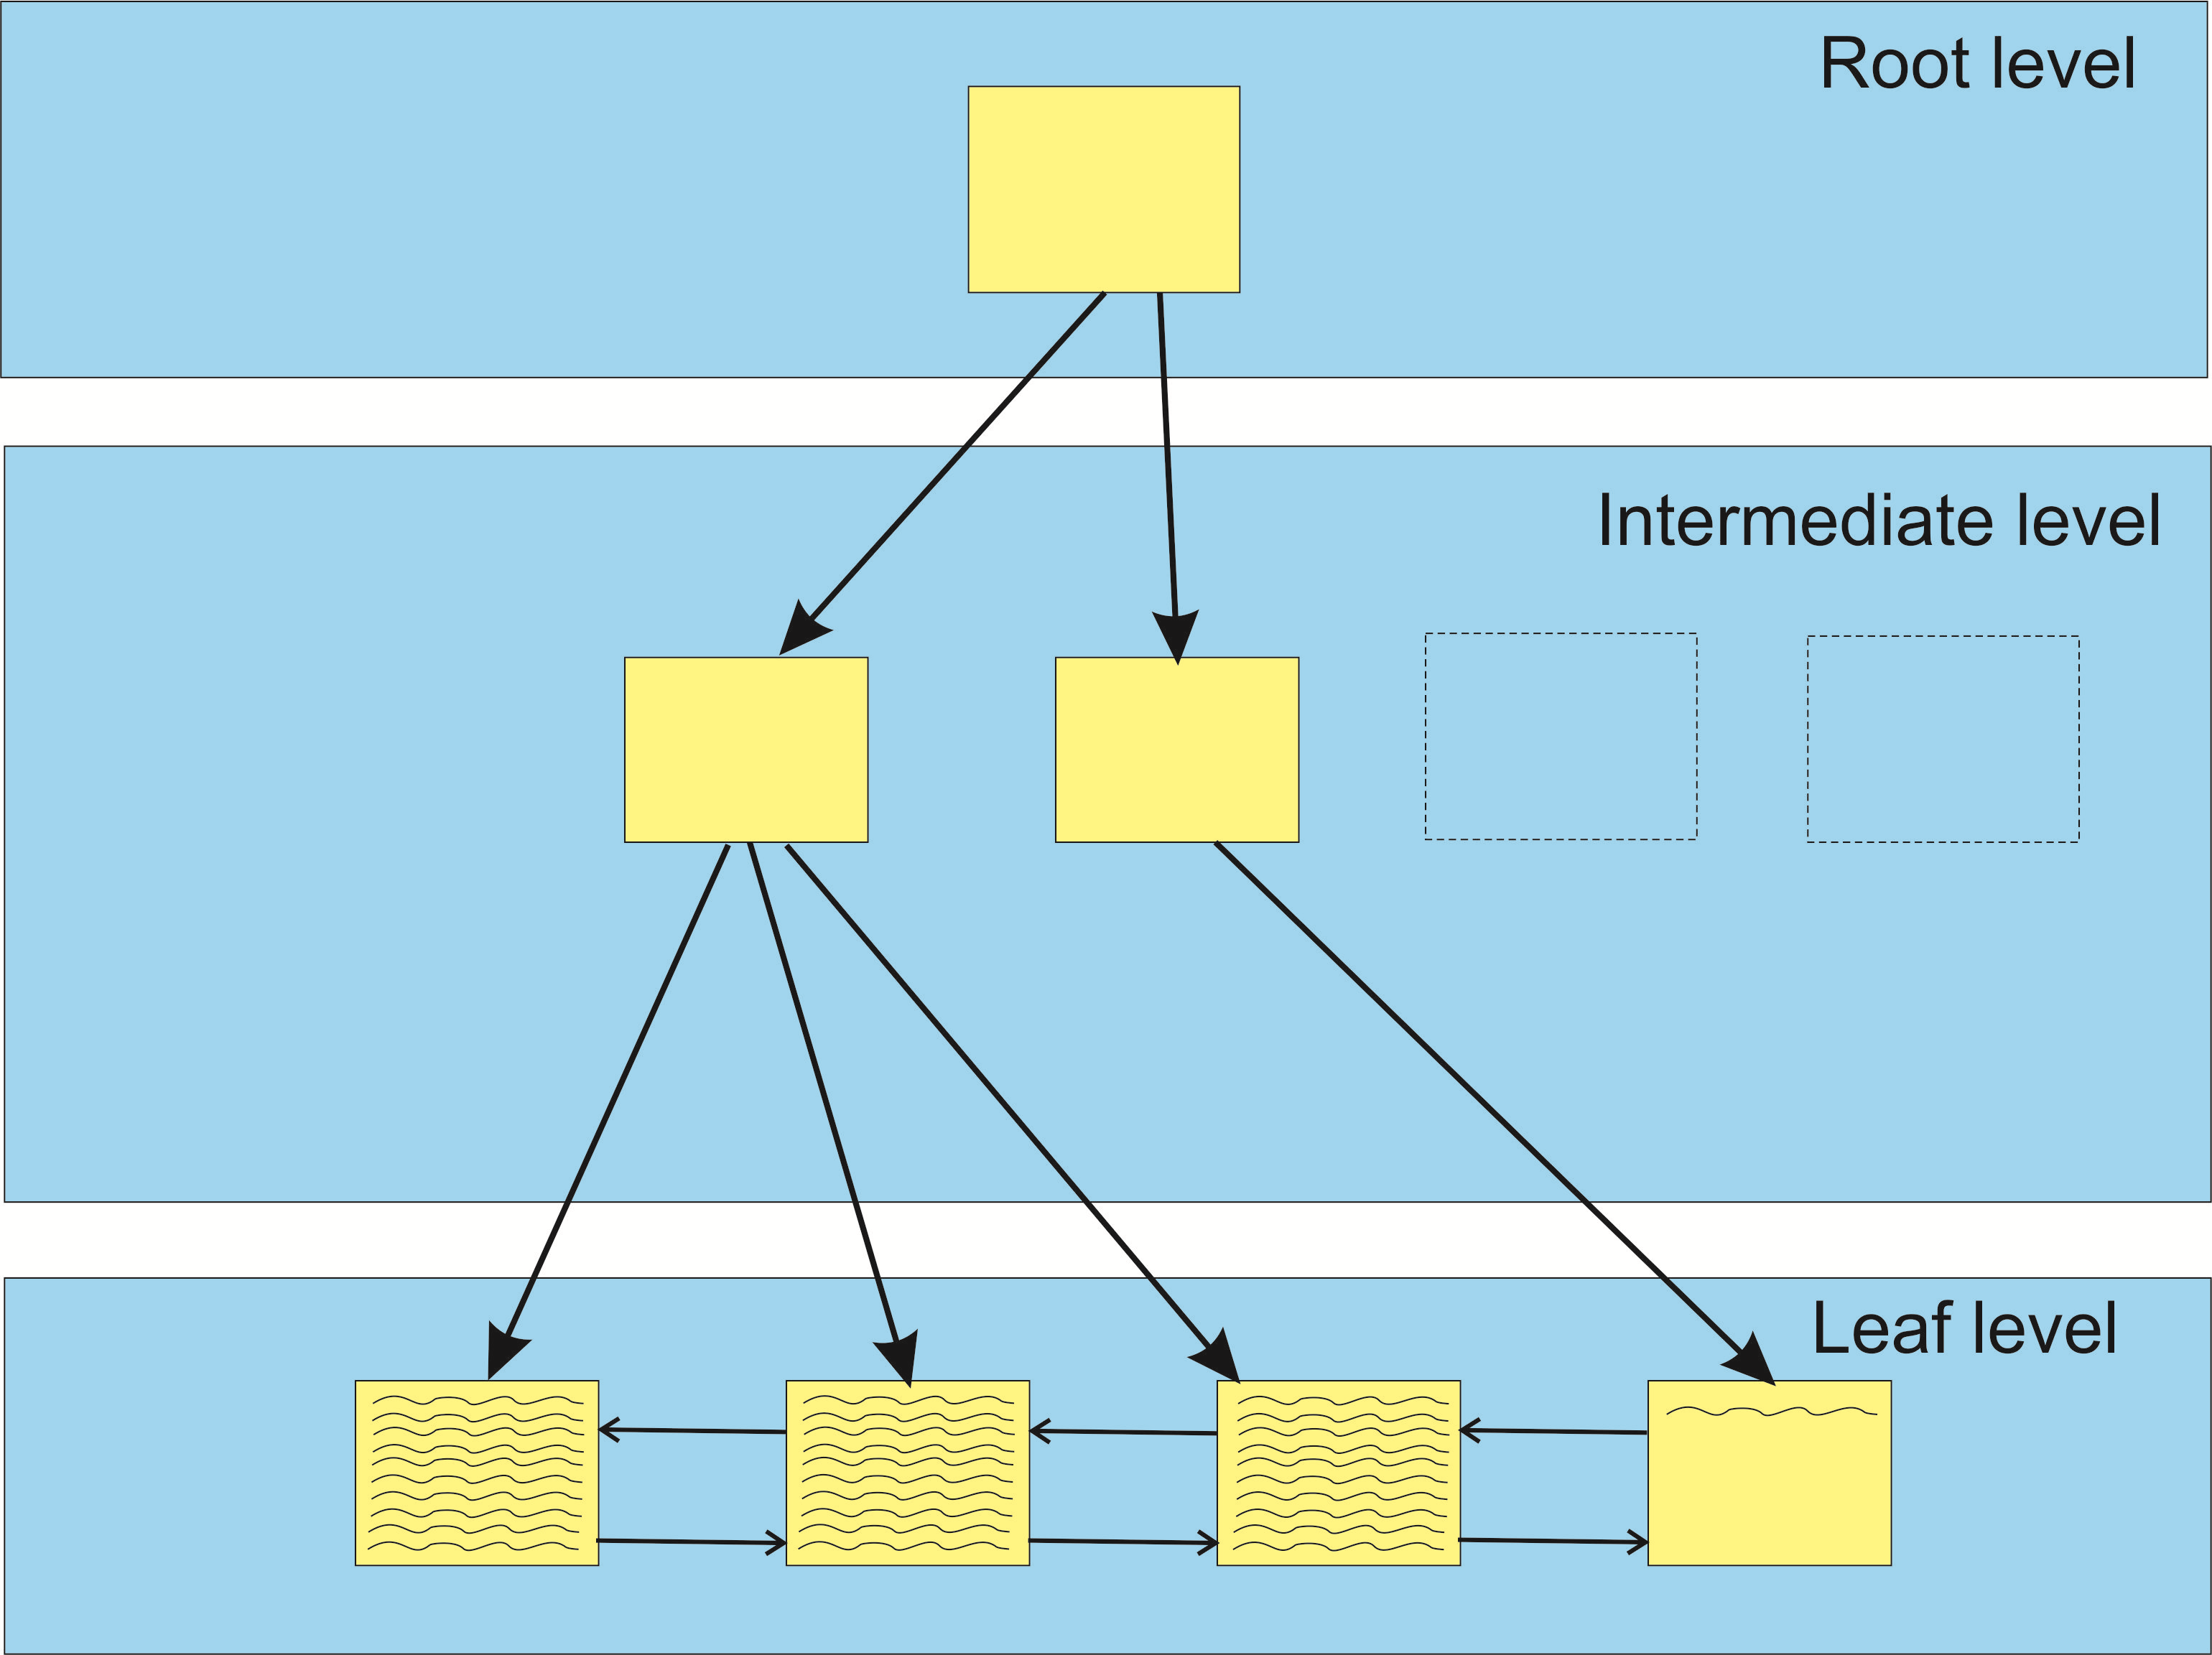
After adding row to index (Identity column, Inter. node expansion)
.
Good Page Split

Slide 15
SQL Server Fill Factor
SQL Server Fill Factor
Good Page Splits
Bad Page Splits
Case study at https://tinyurl.com/yd8mcmvk
Avg bad page split: cpu=0.035ms, logical IOs = 6.1

Slide 16
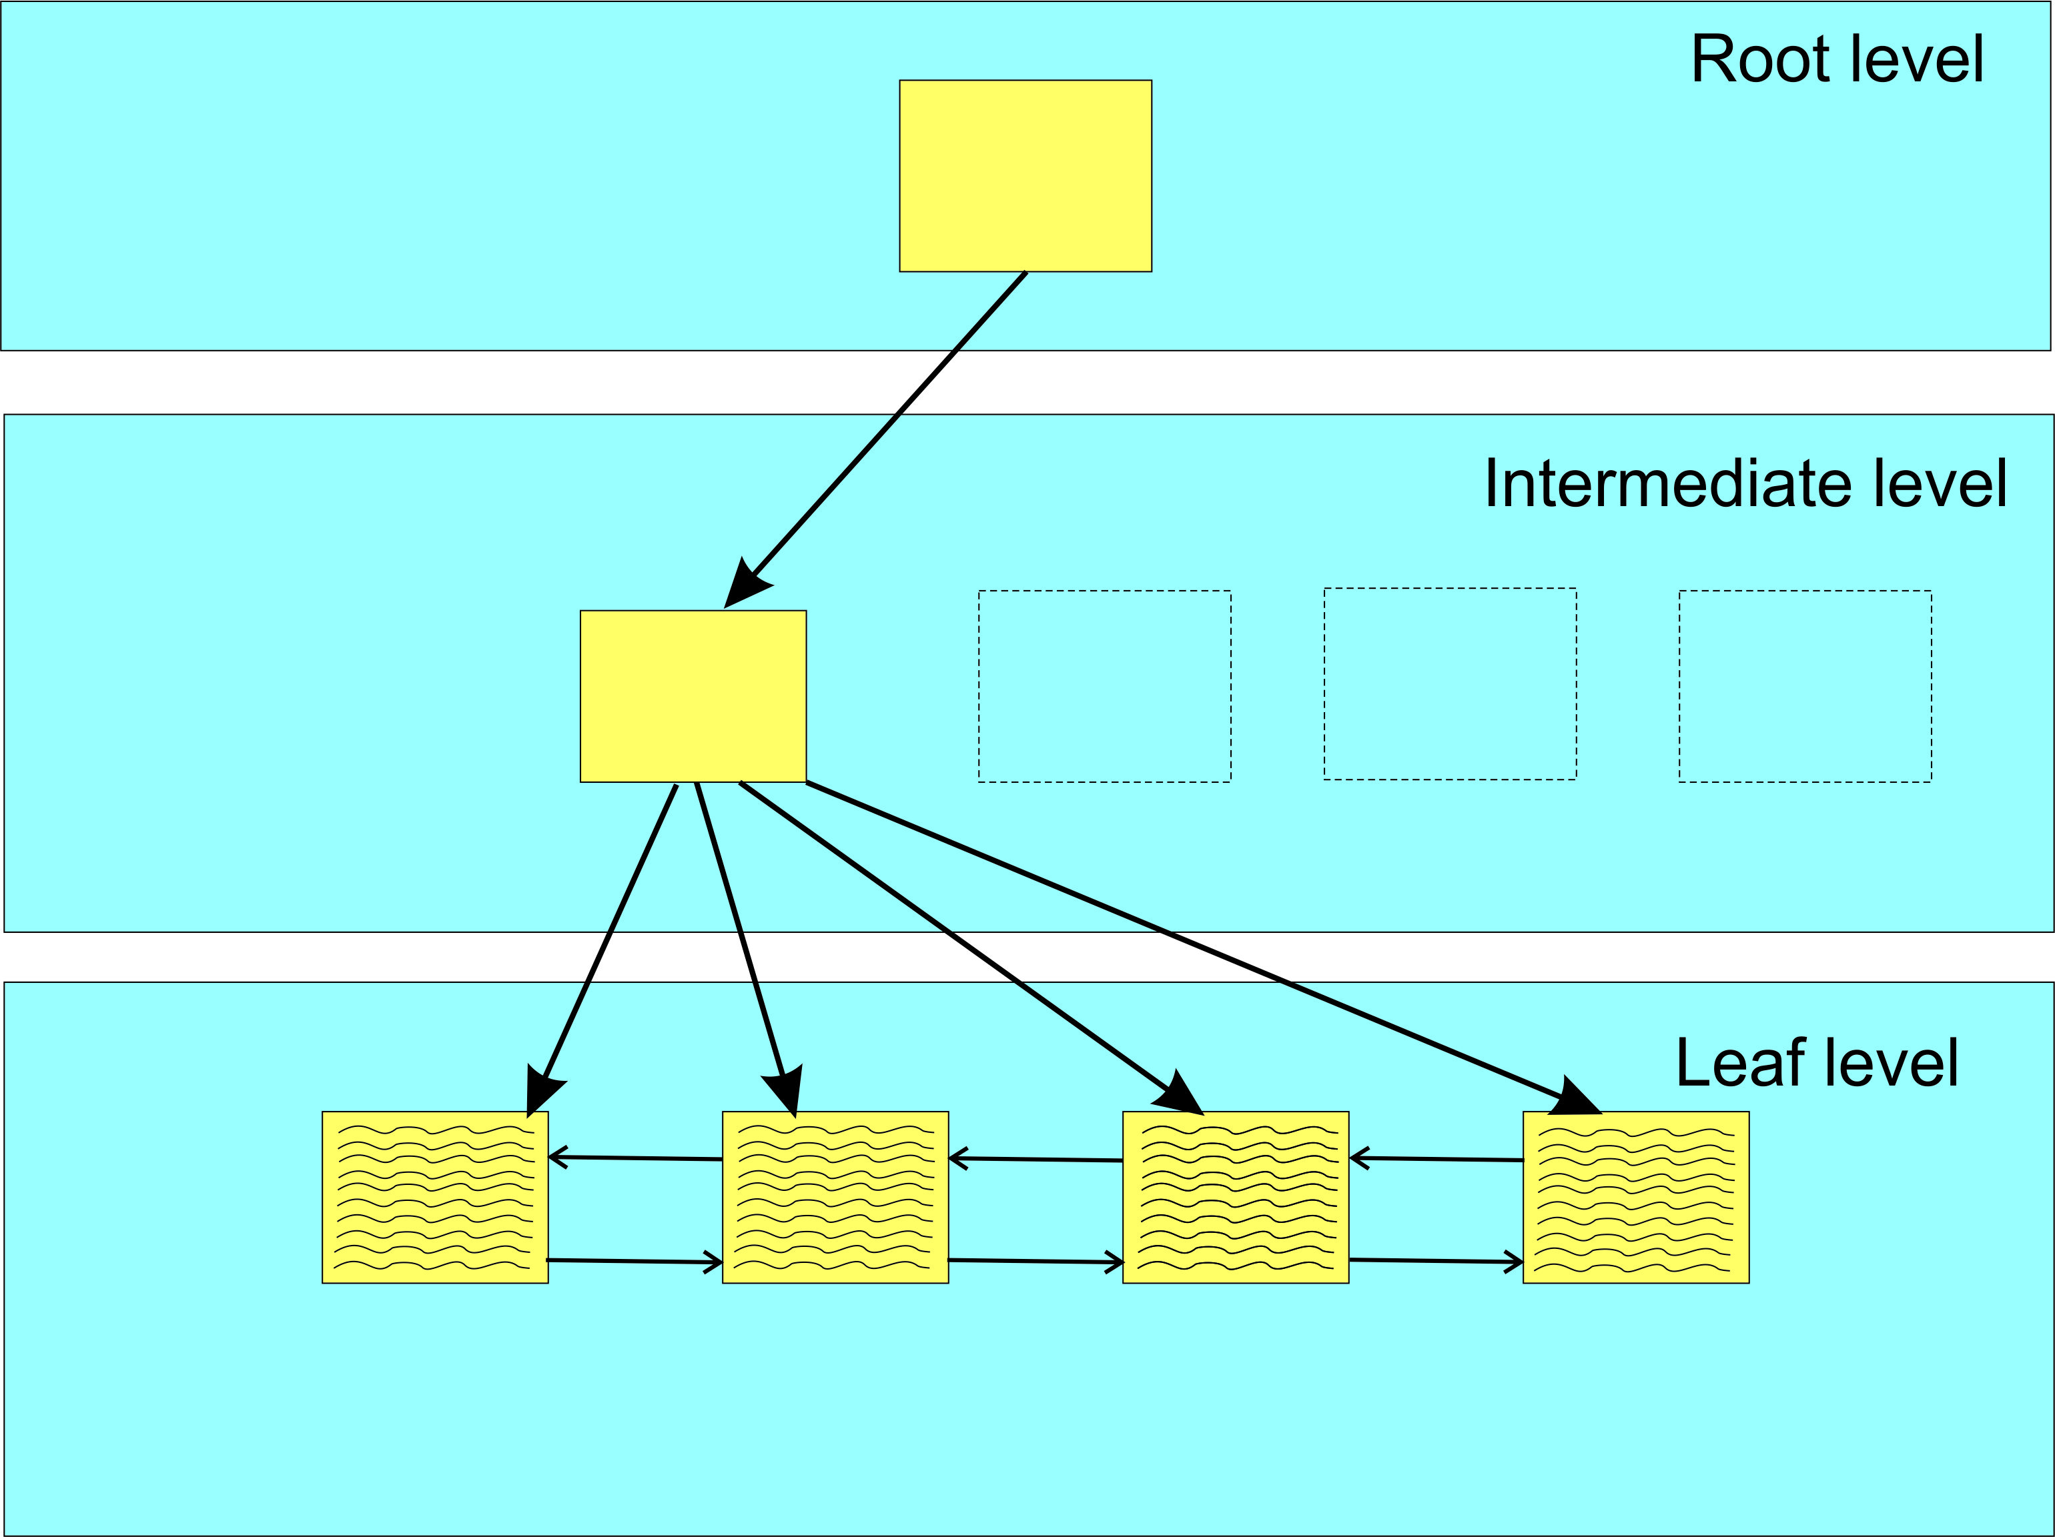
Bad Page Split Example (before row insert, rows aligned with extent)
.

Slide 17
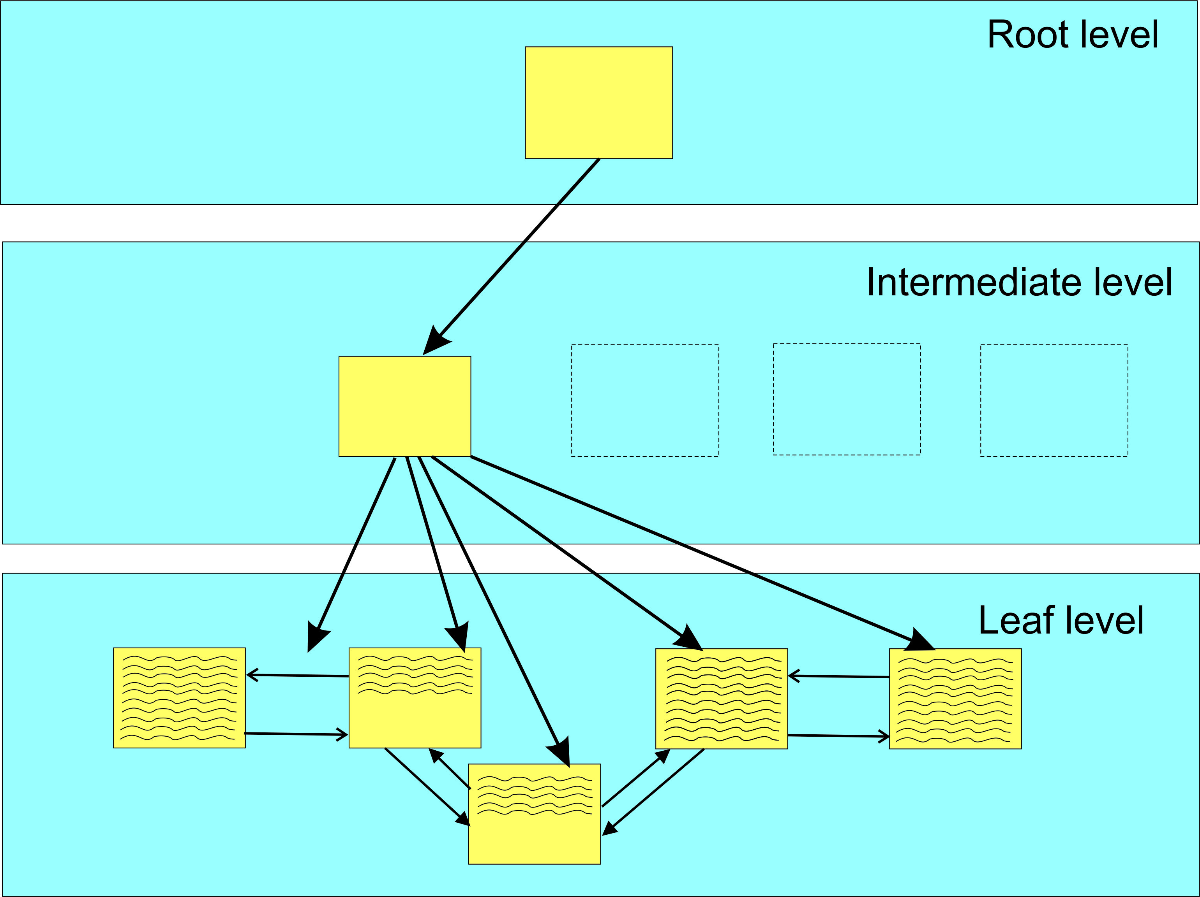
Bad Page Split Example (after row insert, rows not aligned with extent)
.
All the moved data
logged in transaction log
Bad Page Split

Slide 18
Bad Page Split
SQL Server Fill Factor
Good Page Splits
Bad Page Splits
Case study at https://tinyurl.com/yd8mcmvk
Avg bad page split: cpu=0.035ms, logical IOs = 6.1
The trick is to find a value that minimizes bad page splits but doesn’t result in an excessive storage penalty.

Slide 19
Background
About 10 years ago I really dove into indexes and their effect on performance
But I have never really understood how to determine the fill factor for an index
Some guidance, but no definite path
Just no definitive guidance!
What to do????

Slide 20


In a time long, long ago…..

Slide 21
Background
In April 2019, at SQL Saturday 830 (Colorado Springs), I attended two sessions by Jeff Moden titled “Black Arts” & Index Maintenance: How the “Best Practice” Methods are Silently Killing Performance.
Both were outstanding
The bad news is that the links to access those presentations are gone.

Slide 22
Background
In April 2019, at SQL Saturday 830 (Colorado Springs), I attended two sessions by Jeff Moden titled “Black Arts” Index Maintenance: How the “Best Practice” Methods are Silently Killing Performance.
Both were outstanding
The bad news is that the links to access those presentations are gone.
A Reader’s Digest version of his presentations is contrary to the popular concept of reorganizing at 10% fragmentation and rebuilding indexes at 30%.

Slide 23
Background
In April 2019, at SQL Saturday 830 (Colorado Springs), I attended two sessions by Jeff Moden titled “Black Arts” Index Maintenance: How the “Best Practice” Methods are Silently Killing Performance.
Both were outstanding
The bad news is that the links to access those presentations are gone.
A Reader’s Digest version of his presentations is contrary to the popular concept of reorganizing at 10% fragmentation and rebuilding indexes at 30%.
He showed (in the 2 presentations) that page splits caused tremendous performance degradations and that you should probably rebuild indexes at 1% fragmentation.

Slide 24
Background
On the flight back home I got to thinking about everything he said and how fill factor also “factors” into index performance and maintenance.

Slide 25
Background
On the flight back home, I thought about everything he said and how the fill factor also “factors” into index performance and maintenance.
On the flight back home, I thought about everything he said and how the fill factor also “factors” into index performance and maintenance.
It got me thinking about a brute force optimization technique I implemented way back when I worked at the Air Force Rocket Propulsion Laboratory (yes, I was once a rocket scientist and still a geek!).

Slide 26
Background
On the flight back home, I thought about everything he said and how the fill factor also “factors” into index performance and maintenance.
On the flight back home, I thought about everything he said and how the fill factor also “factors” into index performance and maintenance.
It got me thinking about a brute force optimization technique I implemented way back when I worked at the Air Force Rocket Propulsion Laboratory (yes, I was once a rocket scientist and still a geek!).
It was a technique that involved tweaking various parameters (plus and minus percentages) and reducing the tweaks to an “optimum” solution.

Slide 27
Background
On the flight back home, I thought about everything he said and how the fill factor also “factors” into index performance and maintenance.
On the flight back home, I thought about everything he said and how the fill factor also “factors” into index performance and maintenance.
It got me thinking about a brute force optimization technique I implemented way back when I worked at the Air Force Rocket Propulsion Laboratory (yes, I was once a rocket scientist and still a geek!).
It was a technique that involved tweaking various parameters (plus and minus percentages) and reducing the tweaks to an “optimum” solution.
It was not always perfect, as in a multidimensional scenario, there are valleys that this solution could drill down on, but it did offer “near” optimum solutions that let us explore options.

Slide 28
Approach
Take a technique similar to Ola Hallengren’s defrag script and modify it accordingly
His script “reorganizes” at 10% fragmentation and “rebuilds” at 30% fragmentation
I was already using his script with no Reorganize and Rebuilds at 10%.

Slide 29
Approach
Take a technique similar to Ola Hallengren’s defrag script and modify it accordingly
His script “reorganizes” at 10% fragmentation and “rebuilds” at 30% fragmentation
I was already using his script with no Reorganize and Rebuilds at 10%.
Need to tweak performance parameters to evaluate performance and drill down to the best performance value
Need to track performance (fillfactor) and fragmentation for each index (heaps not counted)

Slide 30
Approach
Take a technique similar to Ola Hallengren’s defrag script and modify it accordingly
His script “reorganizes” at 10% fragmentation and “rebuilds” at 30% fragmentation
I was already using his script with no Reorganize and Rebuilds at 10%.
Need to tweak performance parameters to evaluate performance and drill down to the best performance value
Need to track performance (fillfactor) and fragmentation for each index (heaps not counted)
Need a table to contain the parametrics involved with the whole rebuild process for each index rebuild

Slide 31
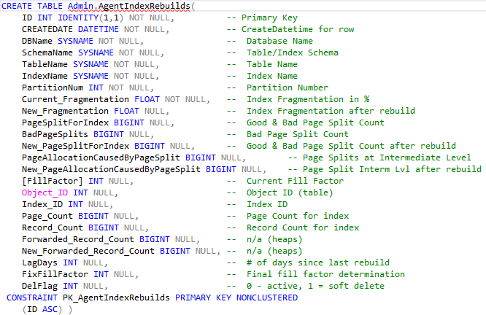
Admin.AgentIndexRebuilds

Slide 32
Approach
Take a technique similar to Ola Hallengren’s defrag script and modify it accordingly
His script “reorganizes” at 10% fragmentation and “rebuilds” at 30% fragmentation
I was already using his script with no Reorganize and Rebuilds at 10%.
Need to track performance and fragmentation for each index (heaps not counted)
Need a table to contain the parametrics involved with the whole rebuild process for each index rebuild
Get TOP 20 indexes with worse fragmentation / bad page splits.

Slide 33
Fragmentation
From Ola’s defrag script we can get average fragmentation in percent
sys.dm_db_index_physical_stats
Yields Average_fragmentation_in_percent, page_count, row_count
sys.dm_db_index_operational_stats
Yields Leaf_Allocation_Count, NonLeaf_Allocation_Count

Slide 34
Fragmentation
From Ola’s defrag script we can get average fragmentation in percent
sys.dm_db_index_physical_stats
Yields Average_fragmentation_in_percent, page_count, row_count
sys.dm_db_index_operational_stats
Yields Leaf_Allocation_Count, NonLeaf_Allocation_Count
Extended event (track bad page splits)
https://www.sqlskills.com/blogs/jonathan/tracking-problematic-pages-splits-in-sql-server-2012-extended-events-no-really-this-time/

Slide 35
Fragmentation
But fragmentation consists of
Logical fragmentation
Fragmentation of database file(s) in the file system
Uniform Extents are owned by one object
Mixed Extents can be shared by up to 8 objects
All new indexes are allocated pages from a mixed extent
Index Level fragmentation
Internal fragmentation (too much free space)
External fragmentation (Pages out of order)

Slide 36
Internal Fragmentation
Internal fragmentation is measured in average page fullness (page density)
A page that is 100% full has no internal fragmentation
Can occur with deletes or where next row cannot fit into the existing page.
Will increase I/O
Decreases efficiency of buffer cache
Increase size of the database file
http://www.practicalsqldba.com/2012/04/sql-server-index-fragmentation.html

Slide 37
External Fragmentation
Happens when logical order of the pages does not match the physical order of the pages.
Measured as percentage of out-of-order pages in the leaf pages of an index.

Slide 38
Code
.
Demo: FillFactorIndexSetup.sql
SQLAgentScriptRebuildIndexes
Bad Page Split

Slide 39
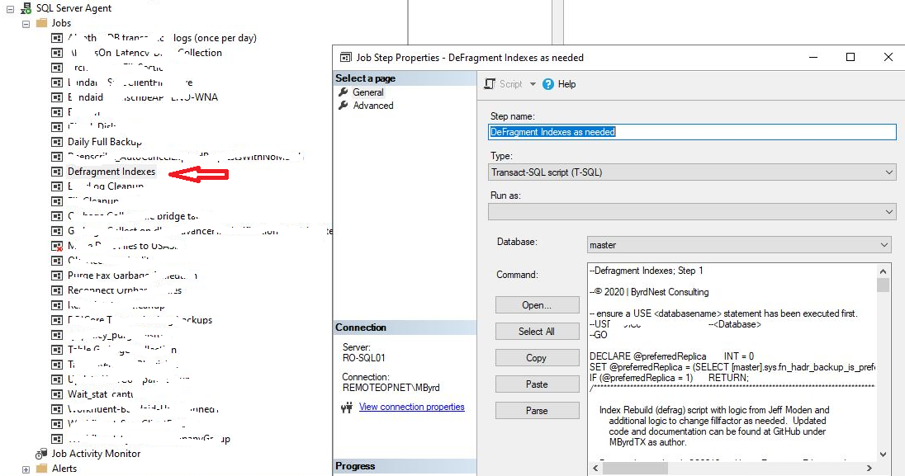
SQL Agent Job
.
Bad Page Split

Slide 40
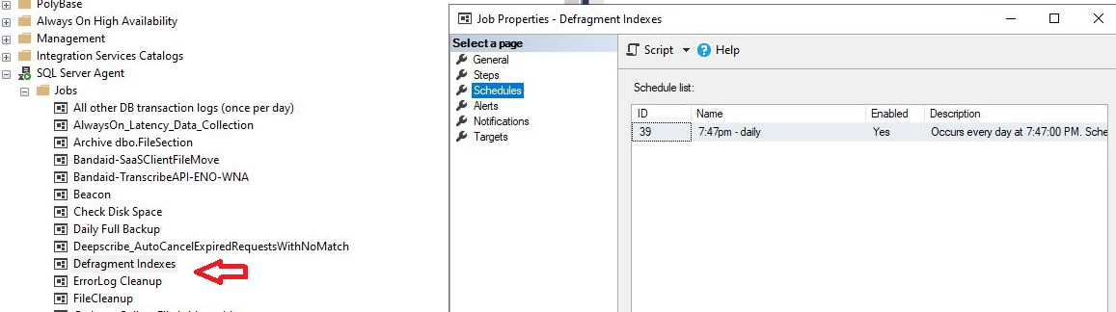
SQL Agent Job
.
Bad Page Split

Slide 41
Analysis - 1
. Initially set up SQL Agent job (nightly) to collect data and vary fill-factor from 100 (default) down
Run during low database activity
As data collected, added new columns to history table and revised logic to determine and/or fix fill factor for each index
Eventually saw need to re-tweak fill factors after period of time (90 days) to allow for new patterns in data access (app changes, data skew)
Bad Page Split

Slide 42
Analysis - 2
Ran data collection on very active client OLTP database
225gb real data (not including sprocs, views, etc.)
249 tables
694 indexes
24x7 environment
In 90 day period only 164 indexes (clustered & nonclustered) recorded and fill factor “tweaked”.
Bad Page Split

Slide 43
Indexes encountered
Clustered Index
Based on a sequential increase (Identity Column)
Based on Parent Table plus the primary key
FileAttribute table {FileID, FileAttributeID, PK = FileAttributeID}
Non-Clustered Index
Usually based on non-PK column
Bad Page Split

Slide 44
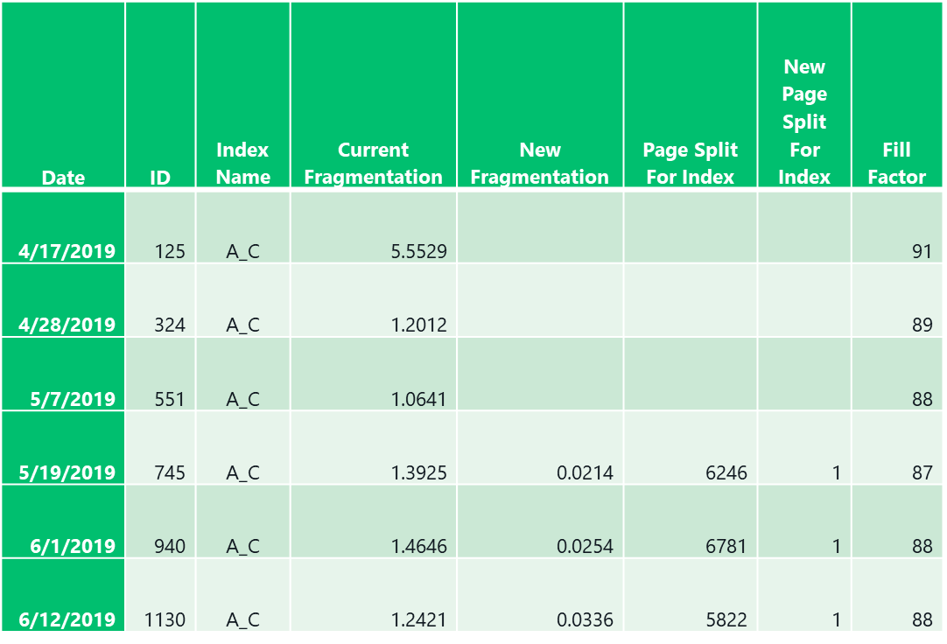
Analysis – 3: Clustered Index based on identity column
Bad Page Split

Slide 45
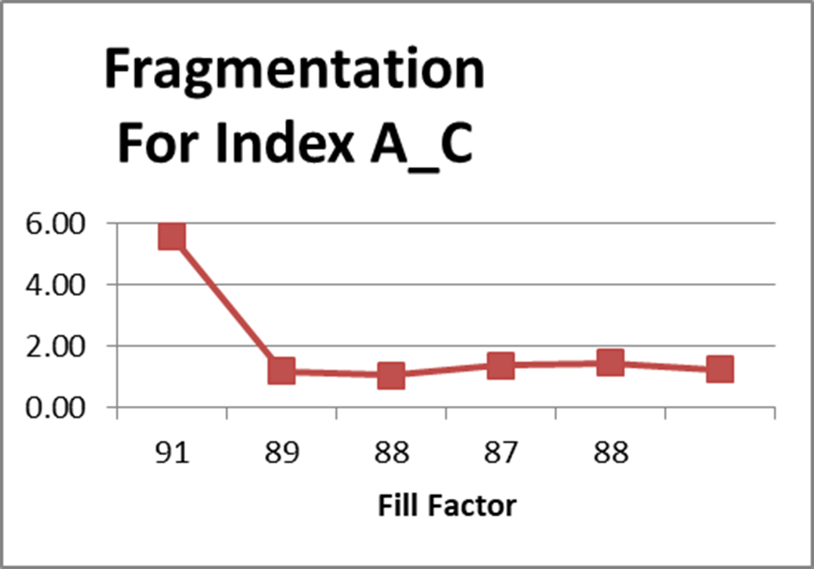
Analysis – 3b: Clustered Index based on identity column
Bad Page Split

Slide 46
Analysis – 4: Clustered Index (many rows inserted with interior pages)
Date | ID | Index Name | Current Fragmentation | New Fragmentation | Page Split For Index | New Page Split For Index | Fill Factor
4/17/2019 | 113 | B_C | 6.548705 |  |  |  | 100
4/25/2019 | 247 | B_C | 1.599545 |  |  |  | 99
4/30/2019 | 377 | B_C | 5.436387 |  |  |  | 98
5/1/2019 | 407 | B_C | 4.856919 |  |  |  | 97
5/7/2019 | 549 | B_C | 1.174713 |  |  |  | 96
5/16/2019 | 691 | B_C | 1.756837 | 0.221820894 | 1037 | 1 | 95
5/24/2019 | 815 | B_C | 1.523979 | 0.233713691 | 897 | 1 | 96
6/2/2019 | 950 | B_C | 1.214119 | 0.220436191 | 644 | 1 | 96
6/7/2019 | 1046 | B_C | 1.151839 | 0.232396003 | 656 | 1 | 96
6/14/2019 | 1167 | B_C | 1.212156 | 0.226648484 | 751 | 1 | 96
Bad Page Split

Slide 47
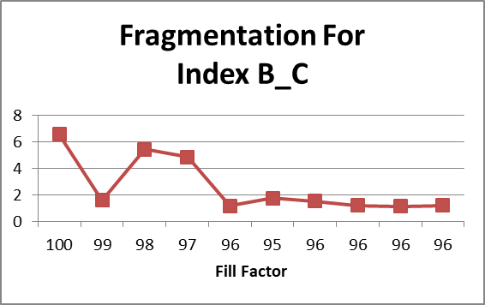
Analysis – 4b: Clustered Index (many rows inserted within interior pages)
Bad Page Split

Slide 48
Analysis – 5: Non-Clustered Index (random interior inserts)
Date | ID | Index Name | Current Fragmentation | New Fragmentation | Page Split For Index | New Page Split For Index | Fill Factor
4/12/2019 | 47 | C_N | 10.92865 |  |  |  | 93
4/17/2019 | 120 | C_N | 5.816024 |  |  |  | 92
4/21/2019 | 172 | C_N | 3.196622 |  |  |  | 91
4/24/2019 | 225 | C_N | 1.979109 |  |  |  | 89
4/26/2019 | 270 | C_N | 1.603421 |  |  |  | 87
4/28/2019 | 328 | C_N | 1.261167 |  |  |  | 85
4/29/2019 | 366 | C_N | 1.029336 |  |  |  | 83
5/1/2019 | 427 | C_N | 1.201803 |  |  |  | 81
5/3/2019 | 465 | C_N | 1.214772 |  |  |  | 79
5/5/2019 | 500 | C_N | 1.145038 |  |  |  | 77
5/8/2019 | 568 | C_N | 1.340111 |  |  |  | 75
5/15/2019 | 685 | C_N | 2.558348 | 0.262582057 | 53 | 1 | 73
5/18/2019 | 730 | C_N | 1.598963 | 0.252631579 | 31 | 1 | 71
5/21/2019 | 776 | C_N | 1.445578 | 0.298359025 | 22 | 1 | 83
5/24/2019 | 823 | C_N | 2.347188 | 0.29455081 | 37 | 1 | 83
5/25/2019 | 834 | C_N | 1.597289 | 0.290697674 | 30 | 1 | 83
5/26/2019 | 848 | C_N | 1.456311 | 0.292255236 | 27 | 1 | 83
5/27/2019 | 864 | C_N | 1.681884 | 0.288461538 | 29 | 1 | 83
5/28/2019 | 877 | C_N | 1.379638 | 0.285986654 | 23 | 1 | 83
5/31/2019 | 926 | C_N | 1.556604 | 0.283822138 | 26 | 1 | 83
6/3/2019 | 968 | C_N | 1.342616 | 0.3 | 16 | 1 | 83
6/5/2019 | 1015 | C_N | 1.535414 | 0.298210736 | 22 | 1 | 83
6/7/2019 | 1055 | C_N | 1.330705 | 0.296735905 | 17 | 1 | 83
6/9/2019 | 1082 | C_N | 1.118568 | 0.281531532 | 8 | 1 | 83
6/11/2019 | 1115 | C_N | 1.563372 | 0.280269058 | 17 | 1 | 83
6/13/2019 | 1156 | C_N | 1.551247 | 0.277932185 | 21 | 1 | 83
6/15/2019 | 1193 | C_N | 1.102536 | 0.276243094 | 16 | 1 | 83
Bad Page Split

Slide 49
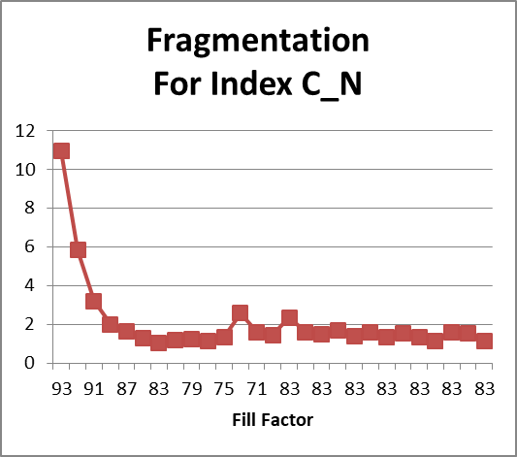
Analysis – 5b: Non-Clustered Index (random interior inserts)
Bad Page Split

Slide 50
Analysis – 6b: Non-Clustered Index (random interior inserts)
Date | ID | Index Name | Current Fragmentation | New Fragmentation | Page Split For Index | New Page Split For Index | Fill Factor
4/15/2019 | 86 | D_N | 8.433735 |  |  |  | 85
4/28/2019 | 349 | D_N | 1.075269 |  |  |  | 83
4/29/2019 | 375 | D_N | 1.052632 |  |  |  | 81
4/30/2019 | 404 | D_N | 1.030928 |  |  |  | 79
5/13/2019 | 658 | D_N | 9.009009 | 0.884955752 | 11 | 1 | 77
Bad Page Split

Slide 51
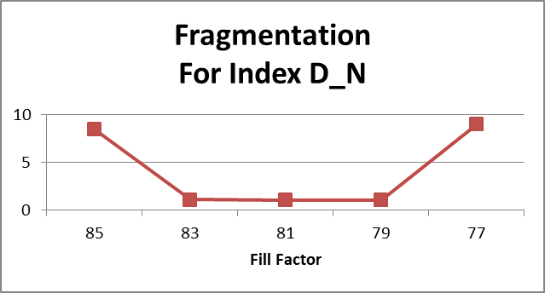
Analysis – 6b: Non-Clustered Index (random interior inserts)
Bad Page Split

Slide 52
Thought process for fixing fill factor
Collect at least 6 data sets for each index
Find the smallest fragmentation
But not in the first 2 data sets (sets 1 & 2)
And not the last data set
If the 6th data set fragmentation is the smallest, then continue to perturb the fill factor on the next run(s) for that index
Identify the fill factor for the smallest fragmentation and set FixFillFactor
Script then checks FixFillFactor and stops tweaking when not null.
Bad Page Split

Slide 53
Analysis:
Unfortunately, we did not have good database benchmarks for performance, but……
Bad Page Split

Slide 54
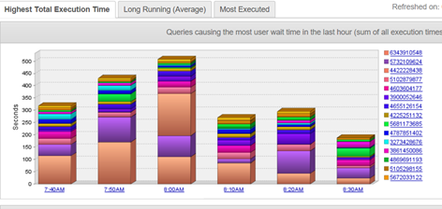
Analysis: DPA screen shot from late Feb 2019 (Typical Server Performance During the Day)
Bad Page Split

Slide 55
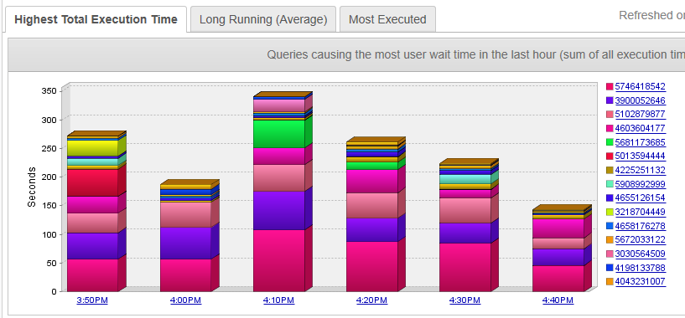
Analysis: DPA screen shot from late June 2019 (Typical Server Performance During the Day)
Bad Page Split

Slide 56
Analysis: Peformance
Overall decrease in database wait times of about 30%
{Yes, I know different times, but screen shots are indicative of performance through the day.}
Bad Page Split

Slide 57
Analysis: Peformance
Overall decrease in database wait times of about 30%
With decreased fragmentation, there are less page splits to wade through for IO range searches
Bad Page Split

Slide 58
Analysis: Peformance
Overall decrease in database wait times of about 30%
With decreased fragmentation, there are fewer page splits to wade through for IO range searches
With an improved fill factor, there are fewer bad page splits.
The cost of a page split can be significant
First, the new page has to be identified, pointers made to it, data movement from the old page to the new page and finally all of this is logged.
Bad Page Split

Slide 59
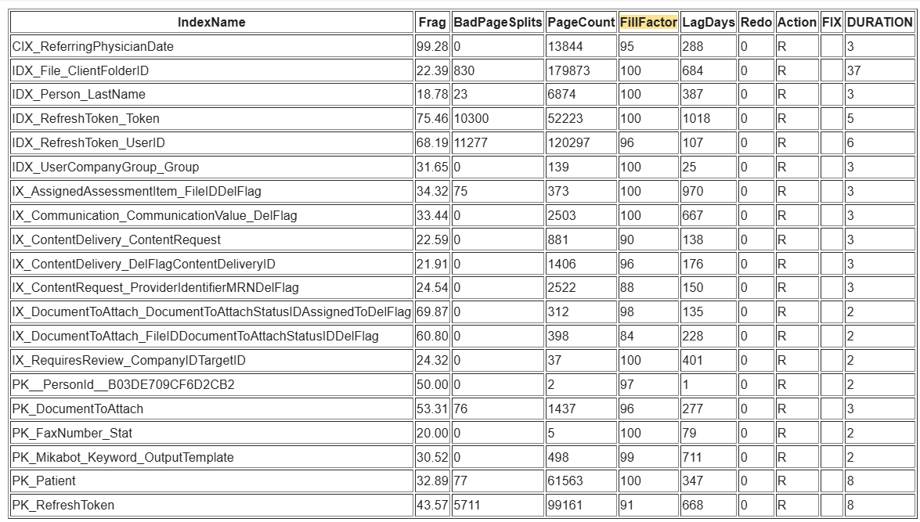
Typical Nightly reports (Weekend):
Bad Page Split

Slide 60
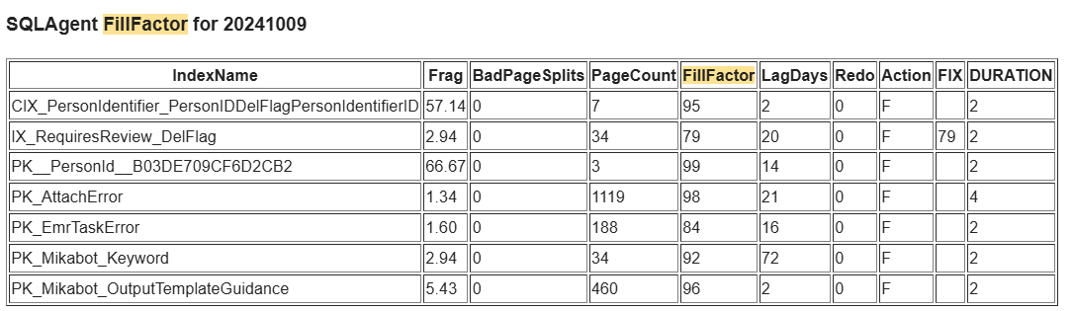
Typical Nightly reports (fragmentation option):
Bad Page Split

Slide 61
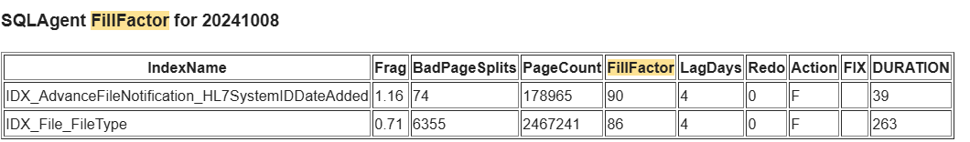
Typical Nightly reports (bad page split option):
Bad Page Split

Slide 62
Requirements:
SQL Server 2012 and above
Enterprise version recommended (OnLine option)
Standard Edition can be used, but have to be wary of schema locks.
Data compression = ROW recommended
Already have in Enterprise
Have in SS2016 SP2 and above for Standard Edition
Bad Page Split

Slide 63
Wish List
Add code for multiple databases on the same server
May want to have separate database for history table
Bad Page Split

Slide 64
Wish List
Add code for multiple databases on the same server
Still, it would be nice to determine the best performance for fill factor value vs pages used.
Bad Page Split

Slide 65
Wish List
Add code for multiple databases on the same server
Still, it would be nice to determine the best performance for fill factor value vs pages used.
Bad Page Split

Slide 66
Wish List
Add code for multiple databases on the same server
Still, it would be nice to determine the best performance for fill factor value vs pages used.
Rewrite code (current code is from proof of concept; I’ve intended to do this last 4 years, but it works with almost no production impact.)
Bad Page Split

Slide 67
Wish List
Add code for multiple databases on the same server
Still, it would be nice to determine the best performance for fill factor value vs pages used.
Rewrite code (current code is from proof of concept; I’ve intended to do this last 4 years, but it works with almost no production impact.)
Current fill factor approach not implemented for partitioned indexes (it would be really nice to have to fill factor per partition; that way, the old data partitions could be set to 100% and the active partitions set as needed. {this should be placed on Microsoft’s wish list ☺})
Bad Page Split

Slide 68
Wish List
Add code for multiple databases on the same server
Still, it would be nice to determine the best performance for fill factor value vs pages used.
Rewrite code (current code is from proof of concept; I’ve intended to do this last 4 years, but it works with almost no production impact.)
Current fill factor approach not implemented for partitioned indexes (it would be really nice to have to fill factor per partition; that way, the old data partitions could be set to 100% and the active partitions set as needed. {this should be placed on Microsoft’s wish list ☺})
Try and build in additional features as suggested by the community.
Bad Page Split

Slide 69
Wish List
Add code for multiple databases on the same server
Still, it would be nice to determine the best performance for fill factor value vs pages used.
Rewrite code (current code is from proof of concept; I’ve intended to do this last 4 years, but it works with almost no production impact.)
Current fill factor approach not implemented for partitioned indexes (it would be really nice to have to fill factor per partition; that way, the old data partitions could be set to 100% and the active partitions set as needed. {this should be placed on Microsoft’s wish list ☺})
Try and build in additional features as suggested by the community.
More testing on performance improvements with firm number.
Bad Page Split

Slide 70
Wish List
Add code for multiple databases on the same server
Still, it would be nice to determine the best performance for fill factor value vs pages used.
Rewrite code (current code is from proof of concept; I’ve intended to do this last 4 years, but it works with almost no production impact.)
Current fill factor approach not implemented for partitioned indexes (it would be really nice to have to fill factor per partition; that way, the old data partitions could be set to 100% and the active partitions set as needed. {this should be placed on Microsoft’s wish list ☺})
Try and build in additional features as suggested by the community.
More testing on performance improvements with firm numbers.
Need better way of monitoring
Admin.AgentIndexRebuilds – both manually and also self-reviewing
Any volunteers out there to implement a dashboard????

Slide 71
Conclusions
This whole idea started as a proof of concept
Offers potential performance benefits
Does demonstrate that effective automatic Fill Factor determination IS possible!
Current code production in production on a very transaction oriented DB for 5 years!

Slide 72
Finally
This concept has been copyrighted with the idea that is belongs to the SQL Server Community
I look forward to constructive critique and suggestions for improvement from the SQL Server Community.

Slide 73

Questions?

Slide 75
Mike Byrd
I hope you got something out of this. It has greatly reduced the 2 am phone calls for me!
Your feedback to me is important
@ByrdNest_TX
Mbyrd@ByrdNest-TX.com
www.TSQLMentoring.com

